Slide 1
EE 5301 – VLSI Design Automation I
Part IV: Floorplanning
Kia Bazargan
University of Minnesota

Slide 2
References and Copyright
Textbooks referred (none required)
  [Mic94] G. De Micheli
  “Synthesis and Optimization of Digital Circuits”
  McGraw-Hill, 1994.
  [CLR90] T. H. Cormen, C. E. Leiserson, R. L. Rivest
  “Introduction to Algorithms”
  MIT Press, 1990.
  [Sar96] M. Sarrafzadeh, C. K. Wong
  “An Introduction to VLSI Physical Design”
  McGraw-Hill, 1996.
  [She99] N. Sherwani
  “Algorithms For VLSI Physical Design Automation”
  Kluwer Academic Publishers, 3rd edition, 1999.

Slide 3
References and Copyright (cont.)
Slides used: (Modified by Kia when necessary)
  [©Sarrafzadeh] © Majid Sarrafzadeh, 2001;
  Department of Computer Science, UCLA
  [©Sherwani] © Naveed A. Sherwani, 1992
  (companion slides to [She99])
  [©Keutzer] © Kurt Keutzer, Dept. of EECS,
  UC-Berekeley
  http://www-cad.eecs.berkeley.edu/~niraj/ee244/index.htm
  [©Gupta] © Rajesh Gupta
  UC-Irvine
  http://www.ics.uci.edu/~rgupta/ics280.html
  [©Kang] © Steve Kang
  UIUC
  http://www.ece.uiuc.edu/ece482/

Slide 4
Floorplanning
Problem
  Given circuit modules (or cells) and their connections, determine the approximate location of circuit elements
  Consistent with a hierarchical / building block design methodology
  Modules (result of partitioning):
    Fixed area, generally rectangular
    Fixed aspect ratio → hard macro (aka fixed-shaped blocks)
    fixed / floating terminals (pins)
    Rotation might be allowed / denied
    Flexible shape → soft macro (aka soft modules)
(w₁,h₁)
(w_{N},h_{N})
Notes:
- Note that the green module in the floorplan shown in the mid-right does not fill its “placeholder”

Slide 5
Floorplanning (cont.)
Objectives:
  Minimize area
  Determine best shape of soft modules
  Minimize total wire length
    to make subsequent routing phase easy
    (short wire length roughly translates into routability)
  Additional cost components:
    Wire congestion (exact routability measure)
    Wire delays
    Power consumption
Possible additional constraints:
  Fixed location for some modules
  Fixed die, or range of die aspect ratio
NP-hard (what did you expect? ☺ )

Slide 6
Floorplanning: Why Important?
Early stage of physical design
  Determines the location of large blocks
  ➔ detailed placement easier (divide and conquer!)
  Estimates of area, delay, power
  ➔ important design decisions
  Impact on subsequent design steps (e.g., routing, heat dissipation analysis and optimization)
L
G
H
D
H
A
J
I
D
C
K
E
C
G
K
I
B
J
B
F
E
L
F
A
Figs: [©Sherwani]

Slide 7
Floorplan Classes
Slicing, recursively defined as:
  A module OR
  A floorplan that can be partitioned into two slicing floorplans with a horizontal or vertical cut line
Non-slicing
  Superset of slicing floorplans
  Contains the “wheel” shape too.
1
3
Slicing
floorplan
2
4
7
6
5
Corresp.
Slicing
tree
1234567
167
2345
67
1
234
5
6
7
2
34
3
4
Non-Slicing
floorplan
[©Sarrafzadeh]
Notes:
The non-slicing floorplan shown here is the smallest non-slicing floorplan.
Furthermore, it’s the only basic shape that cannot be represented using a slicing tree

Slide 8
Non-slicing Floorplan Example
Hierarchical floorplan of order 5
  Templates
  Floorplan and tree example
L5
R5
2
R5
3
1
4
3
5
6
1
6
2
7
8
7
8
4
5
[©Sarrafzadeh]

Slide 9
Floorplanning Algorithms
Components
  “Placeholder” representation
    Usually in the form of a tree
    Slicing class: Polish expression [Otten]
    Non-slicing class: O-tree, Sequence Pair, BSG, etc.
    Just defines the relative position of modules
  Perturbation
    Going from one floorplan to another
    Usually done using Simulated Annealing
  Floorplan sizing
    Definition: Given a floorplan tree, choose the best shape for each module to minimize area
    Slicing: polynomial, bottom-up algorithm
    Non-slicing: NP! Use mathematical programming (exact solution)
  Cost function
    Area, wire-length, ...
The rest of the
slides deal with
slicing floorplans

Slide 10
Area Utilization, Hard and Soft Modules
The hierarchy tree and floorplan
define “place holders” for modules
Area utilization
  Depends on how nicely
  the rigid modules’ shapes are matched
  Soft modules can take different shapes to
  “fill in” empty slots ➔ floorplan sizing
1
2
3
m3
m1
m3
m1
m1
m2
m2
4
m4
m4
7
6
m7
m7
5
m6
m6
m5
m7
m5
m7
m7
Area = 20x22 = 440
Area = 20x19 = 380
Notes:
Assuming all modules are soft with absolute flexibility (i.e., fixed area, any aspect ratio), how can you size a floorplan?

Slide 11
Floorplan Sizing for Slicing Floorplans
Bottom-up process
Has to be done per floorplan perturbation
Requires O(n) time.
  N is the total number of shapes of all the modules
V
H
L
R
T
B
b_{i}
a_{i}
b_{i}+y_{j}
b_{i}
y_{j}
max(b_{i}, y_{j})
y_{j}
a_{i}
x_{j}
x_{j}
a_{i}+ x_{j}
max(a_{i}, x_{j})
[©Sarrafzadeh]

Slide 12
Sizing Slicing Floorplans
Simple case:
  All modules are hard macros
  No rotation allowed
  ➔ one shape only
3
1
2
4
7
6
5
17x16
1234567
9x15
167
2345
8x16
m3
m1
9x7
67
1
234
8x11
5
m2
m4
8x8
7x5
m6
6
7
2
34
4x11
m7
m5
4x7
5x4
4x8
3
4
3x6
4x5
Notes:
Does the exact order in which we perform the sizing matter?
No. As long as it’s a bottom-up order, the exact order doesn’t matter (e.g., [34] can be sized before or after [67])
When doing the bottom-up sizing, can we determine the location of the bottom-left corner of each block?

Slide 13


Sizing Slicing Floorplans (cont.)
What if modules have more than one shape?
If area only concern:
  Module A has shapes 4x6, 7x8, 5x6, 6x4, 7x4,
  which ones should we pick?
  Module A has shapes 4x6, 5x5, 6x4,
  which ones should we pick?
  (what if B is 3x5?!)
Dominant points
  Shape (x₁, y₁) dominates (x₂, y₂)
  if x₁ ≤ x₂ and y₁ ≤ y₂.
A
B
γ
p
q
α dominates p
α
β dominates r
β
r
β dominates q
Notes:
Can area alone be a factor in eliminating a shape? (e.g., 4x6, 5x5)

Slide 14
Sizing Slicing Floorplans: Example
a1
a2
A
B
a3
4x6
5x5
6x4
b1
b1
b1
b1
a1
a2
a3
2x7
6x7
7x7
8x7
a1
a2
b2
b2
b2
a3
b2
3x4
7x6
8x5
9x4
a1
a2
a3
b3
b3
b3
b3
4x2
8x6
9x5
10x4
Notes:
Note that the shapes are sorted (decreasing height)
Claim: if you sort the shapes on decreasing height, the widths HAVE TO be in increasing order. Why?
Each dominating width or height will eliminate the elements to the right of an item in a row, or the elements to the bottom of an element in a column.
Why does a1,b1 eliminate a2,b1 and a3,b1?
Note that the resulting shapes are also in inc height / dec width order
What if we are dealing with a horizontal cut?

Slide 15
Slicing Floorplan Sizing Algorithm
Procedure Vertical_Node_Sizing
Input: Two sorted lists L = { (a₁, b₁), ... , (a_{s},b_{s}) },
R = { (x₁, y₁), ... , (x_{t}, y_{t}) }
where a_{i} < a_{j}, b_{i} > b_{j}, x_{i} < x_{j}, y_{i} > y_{j} for all i < j
Output: A sorted list H = { (c₁, d₁), ... , (c_{u},d_{u}) }
where u ≤ s + t - 1, c_{i} < c_{j}, d_{i} > d_{j} for all i < j
begin-1
H := φ
i := 1, j := 1, k = 1
while (i ≤ s) and (j ≤ t) do
begin-2
(c_{k}, d_{k}) := (a_{i} + x_{j}, max(b_{i}, y_{j}))
H := H ∪ { (c_{k}, d_{k}) }
k := k + 1
if max(b_{i}, y_{j}) = b_{i} then i := i + 1
if max(b_{i}, y_{j}) = y_{j} then j := j + 1
end-2
end-1
[©Sarrafzadeh]
Notes:
What happens if bi == yj? Would the algorithm still work correctly?
What change do we have to make to do horizontal node sizing? Can we keep the sorting order?

Slide 16
Slicing Floorplan Sizing
Input: floorplan tree, modules shapes
Start with sorted shapes lists of modules
In a bottom-up fashion, perform:
  Vertical_Node_Sizing
  AND
  Horizontal_Node_Sizing
When get to the root node, we have a list of shapes. Select the one that is best in terms of area
In a top-down fashion, traverse the floorplan tree and set module locations

Slide 17
Wire Length
For hyperedges:
  Either of complete graph, MST, or Steiner tree
For each edge:
  Euclidian distance sqrt( (x₁-x₂)² + (y₁-y₂)² ).
    Direct lines
  Manhattan distance |x₁ – x₂| + |y₁ – y₂|
    Manhattan: Only horizontal / vertical lines
(a) Steiner tree
(b) minimum spanning tree
(c) complete graph
(length = 13)
(length = 11)
(length = 32)
[©Sherwani]

Slide 18
Polish Expression
Tree representation of the floorplan
  Left child of a V-cut in the tree represents
  the left slice in the floorplan
  Left child of an H-cut in the tree represents
  the top slice in the floorplan
Polish expression representation
  A string of symbols obtained by traversing a binary tree in post-order.
3
1
2
4
7
6
5
1
5
7
6
2
3
4
1 7 6 | - 2 3 4 - | 5 - |
Notes:
How to uniquely represent a floorplan using a tree?
In a Polish expression, can the last character be an operand? Can the first or the second character be an operator?
If we traverse a Polish expression from left to right, and use a counter to increment when we see an operand and decrease when we get to an operator, what is the physical meaning of such a counter? Can we get to a count value of zero? At the end, what should be the value?
What data structure can we use to convert a Polish expression to a tree?

Slide 19
Normalized Polish Expression
Problem with Polish expressions?
  Multiple representations for some slicing trees
    When more than one cut in one direction cut a floorplan
  Larger solution space
  A stochastic algorithm (e.g., Simulated Annealing) will be more biased towards floorplans with multiple representations
    (More likely to be visited)
4
1
3
3
4
2
1
2
3
4
1
2
1 2 - 3 4 | |
1 2 - 3 | 4 |
[©Sarrafzadeh]
Notes:
Is any of the shown trees better?
No. Both generate the same floorplan with the same area (sizing is done in linear time in both cases too).

Slide 20
Normalized Polish Expression (cont.)
Solution?
  Assign priorities to the cuts
  In a top-down tree construction,
    Pick the right-most cut
    Pick the lowest cut
  Result: no two same operators
  adjacent in the Polish expression
  (i.e., no “| |” or “— —”)
4
3
5
1
1
2
2
3
4
1 2 – 5 - 3 | 4 |
5
Notes:
We picked this representation, because maybe it’s easier to check.

Slide 21
Simulated Annealing
Idea originated from observations of crystal formations (e.g., in lava)
  A crystal is in a low energy state
  Materials tend to form crystals (global minimum)
  If at the right temperature (i.e., right speed), a molecule will adhere to a crystal formation
Very slowly decrease temperature
  When very hot, molecules move freely
    When a molecule gets to a chunk of crystal,
    it *might* move away due to its high speed
  When colder, molecules slow down
    The probability of moving away from a local optimum decreases
  When the material “freezes”, all molecules are fixed and the material is in minimum energy state

Slide 22
Simulated Annealing Algorithm
Components:
  Solution space (e.g., slicing floorplans)
  Cost function (e.g., the area of a floorplan)
    Determines how “good” a particular solution is
  Perturbation rules
  (e.g., transforming a floorplan to a new one)
  Simulated annealing engine
    A variable T, analogous to temperature
    An initial temperature T₀ (e.g., T₀ = 40,000)
    A freezing temperature T_{freez} (e.g., T_{freez}=0.1)
    A cooling schedule (e.g., T = 0.95 * T)
Notes:
What properties should the perturbation rules have?
Fast
Cover all the solution space
Not biased towards a particular class of solutions

Slide 23
Simulated Annealing Algorithm
Procedure SimulatedAnnealing
curSolution = random initial solution
T = T₀ // initial temperature
while (T > T_{freez}) do
for i=1 to NUM_MOVES_PER_TEMP_STEP do
nextSol = perturb (curSolution)
Δcost = cost(nextSol) – cost(curSolution)
if acceptMove (Δcost, T) then
curSolution = nextSol // accept the move
T = coolDown (T )
Procedure acceptMove (Δcost, T)
if Δcost < 0 then return TRUE // always accept a good move
else
boltz = e^{-Δcost / k T} // Boltzmann probability function
r = random(0,1) // uniform rand # between 0&1
if r < boltz then return TRUE
else return FALSE
Notes:
Think of the boltz exp function as a mapping process that maps delta_cost to [0,1] on the average at the beginning, and to [0,0] at the end. (“on the average” is important).
So, when you generate a uniformly random number between [0,1], chances that it is less than “boltz” – i.e., you accept a bad move (on the average over that particular temperature) is going to be equal to “boltz”.

Slide 24
Simulated Annealing: Move Acceptance
Good moves are always accepted
Accepting bad moves:
  When T = T₀, bad move acceptance probability ≈ 1
  When T = T_{freez}, Bad move acceptance probability = 0
Boltzmann probability function?!?
  boltz = e^{-Δcost / k T}.
  k is the Boltzmann constant,
  chosen so that all moves at the initial temperature
  are accepted

Slide 25


Simulated Annealing: More Insight...
Annealing steps

Slide 26
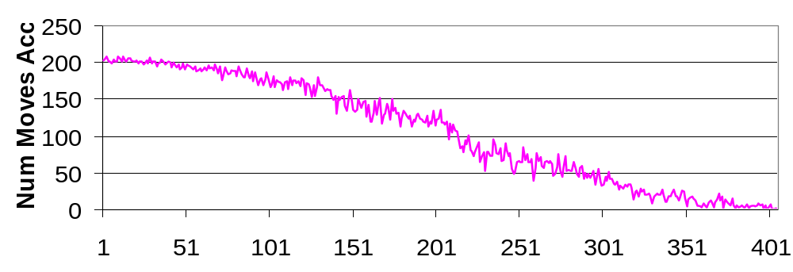
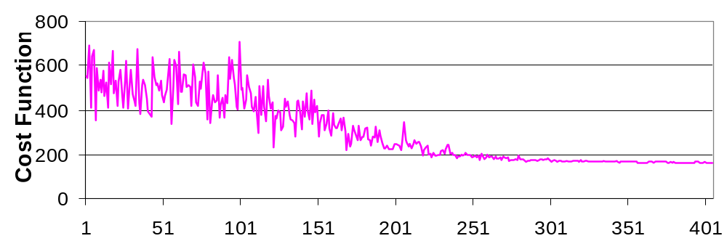
Simulated Annealing: More Insight...

Slide 27
Wong-Liu Floorplanning Algorithm
Uses simulated annealing
Normalized Polish expressions represent floorplans
Cost function:
  cost = area + λ totalWireLength
  Floorplan sizing is used to determine area
  After floorplan sizing, the exact location of each module is known, hence wire-length can be calculated
Perturbation?....
Notes:
What will a designer do, if wire length is more important than the area?

Slide 28
Wong-Liu Floorplanning Algorithm (cont.)
Moves:
  OP1: Exchange two operands that have
  no other operands in between
  OP2: Complement a series of operators
  between two operands
  OP3: Exchange adjacent operand and operator if the resulting expression still a normalized Polish exp.
4
3
2
4
3
4
2
4
3
OP1
1
2
OP2
OP3
1
1
2
1
3
12 | 4 – 3 |
12 | 3 – 4 |
12 - 3 – 4 |
12 - 3 4 - |
[©Sarrafzadeh]
Notes:
Why these moves?
Can we replace OP2 with a move that flips only one operator?
No. It will violate the normalized condition (if you avoid it, it might prohibit the moves set to reach all solutions)

Slide 29
Other Floorplanning Methods
Rectangular dual graph
Linear programming (floorplan sizing)
Non-slicing methods
  Sequence-pair
  Bounded slice line grid
  O-tree
  Corner block list

Slide 30
To Probe Further...
Andrew B. Kahng,
“Classical Floorplanning Harmful?",
Int’l Symposium on Physical Design (ISPD), pp. 207-213, 2000.
(survey + future directions)
F. Y. Young and D. F. Wong,
“Slicing Floorplans With Range Constraint”,
Int’l Symposium on Physical Design (ISPD), pp. 97-102, 1999.
(extension of Wong-Liu, some modules restrained to some regions)
K. Bazargan, S. Kim and M. Sarrafzadeh,
“Nostradamus: A Floorplanner of Uncertain Designs”,
Int’l Symposium on Physical Design (ISPD), pp. 18-23, 1998.
(extension of Wong-Liu, notion of flexibility of a floorplan)

Slide 31
To Probe Further...
H. Murata, K. Fujiyoshi, S. Nakatake and Y. Kajitani,
“Rectangle-Packing-Based Module Placement",
Conference on Computer Aided Design (ICCAD), pp. 472-479, 1995.
(“Sequence Pair” non-slicing floorplan representation)
X. Hong, G. Huang, Y. Cai, et. al.,
“Corner Block List: an Effective and Efficient Topological Representation of Non-slicing Floorplan”,
Int’l Conference on Computer Aided Design (ICCAD), pp. 8-12, 2000.
(non-slicing floorplan representation)
Yingxin Pang , Chung-Kuan Cheng , Koen Lampaert , Weize Xie,
“Rectilinear block packing using O-tree representation",
Int’l Symposium on Physical Design (ISPD), pp. 156-161, 2001.
(extension of the non-slicing floorplan representation “O-tree” to handle L-shaped modules)

